Slide 1

7 PETALS HORTICULTURE
(INDIA) PVT. LTD.

Slide 2
ESTABLISHED ON 25TH AUGUST 2014
OFFICE – VIKHROLI EAST, MUMBAI
NURSERY – KARJAT

Slide 3
The Directors are qualified Horticulturists with education in the field of Agriculture & Horticulture possessing knowledge and experience in the field for more than 25 years.
They have executed all types of jobs and concepts in the field of Landscaping and retain profound knowledge of plants and gardens.
They Have experience of establishment & managing a commercial plant Nursery and developing Farms.
We have diversified our services from last 5 years and are executing complete Landscape project which includes all aspects of a project viz. Civil works, Softscape works, Fabrication, Lighting, Painting, Irrigation, Play Grounds etc.

Slide 4
SERVICES OFFERED
Landscaping- Turn Key- Hardscape & Softscape
Green Wall / Vertical Gardens
Tree Planting & Tree Transplanting
Roof / Terrace Gardens
Garden Maintenance
Irrigation Systems
Supply of plants & garden materials
Green House/ Shade House Construction
Horticultural Consultancy

Slide 5
STAFF
DIRECTORS- 7
GENERAL MANAGER- 2
BILLING ENGINEERS-3
CIVIL ENGINEER- 4
HORTICULTURIST- 7
IRRIGATION ENGINEER-1
SUPERVISORS- 10
OFFICE STAFF- 4
GARDENERS & MASONS- 100
MASONS & HELPERS- AS REQUIRED

Slide 6

















OUR CLIENTS

Slide 7
PROJECTS

Slide 8
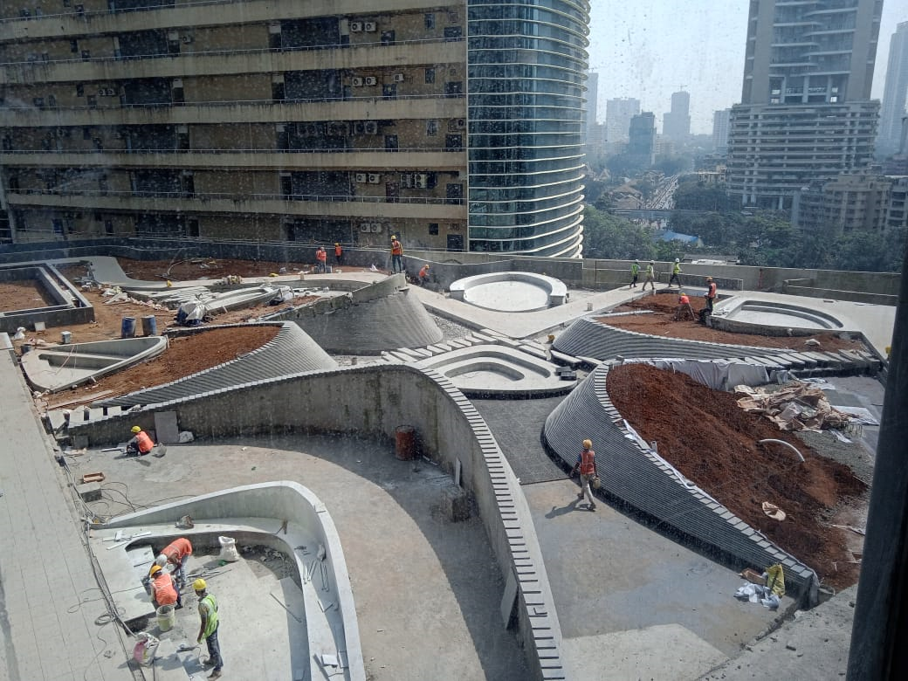
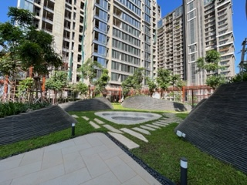
Rustomjee Crown

Slide 9
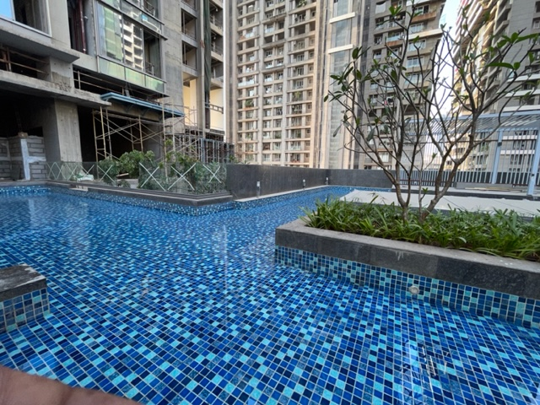
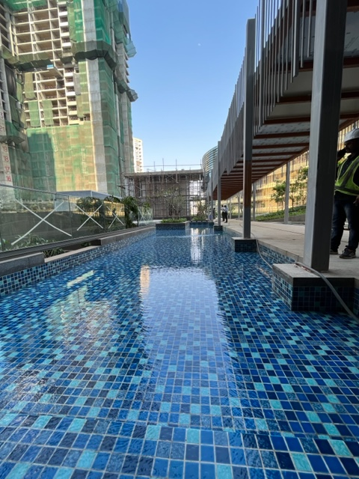
Rustomjee Crown

Slide 10
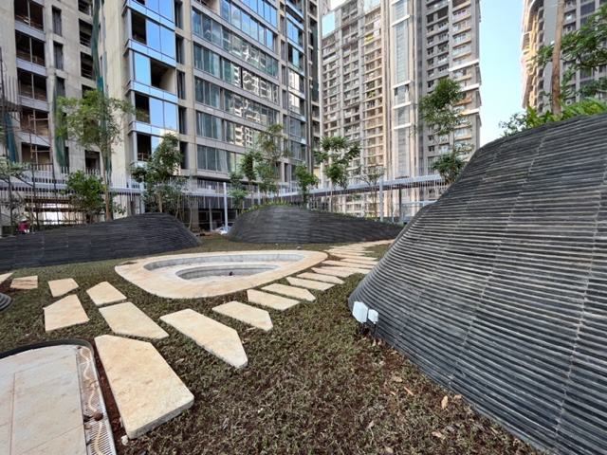
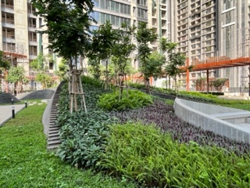
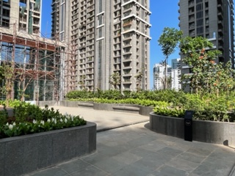
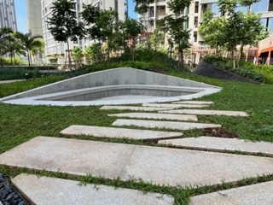
Rustomjee Crown

Slide 11
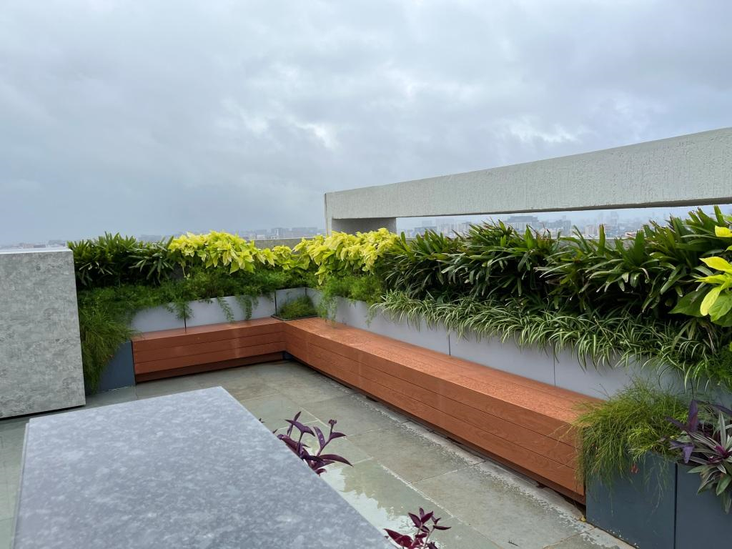
RUSTOMJEE PARAMOUNT, KHAR

Slide 12
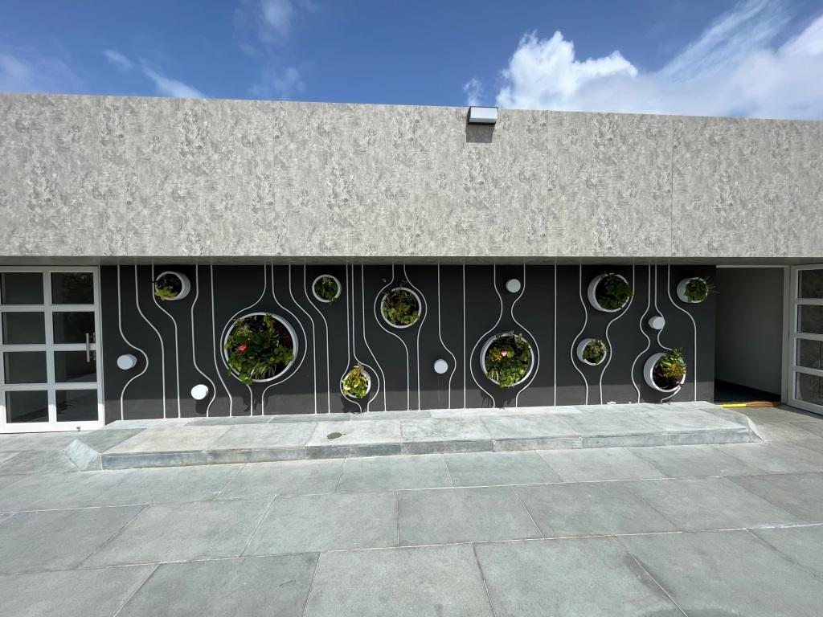
RUSTOMJEE PARAMOUNT, KHAR

Slide 13
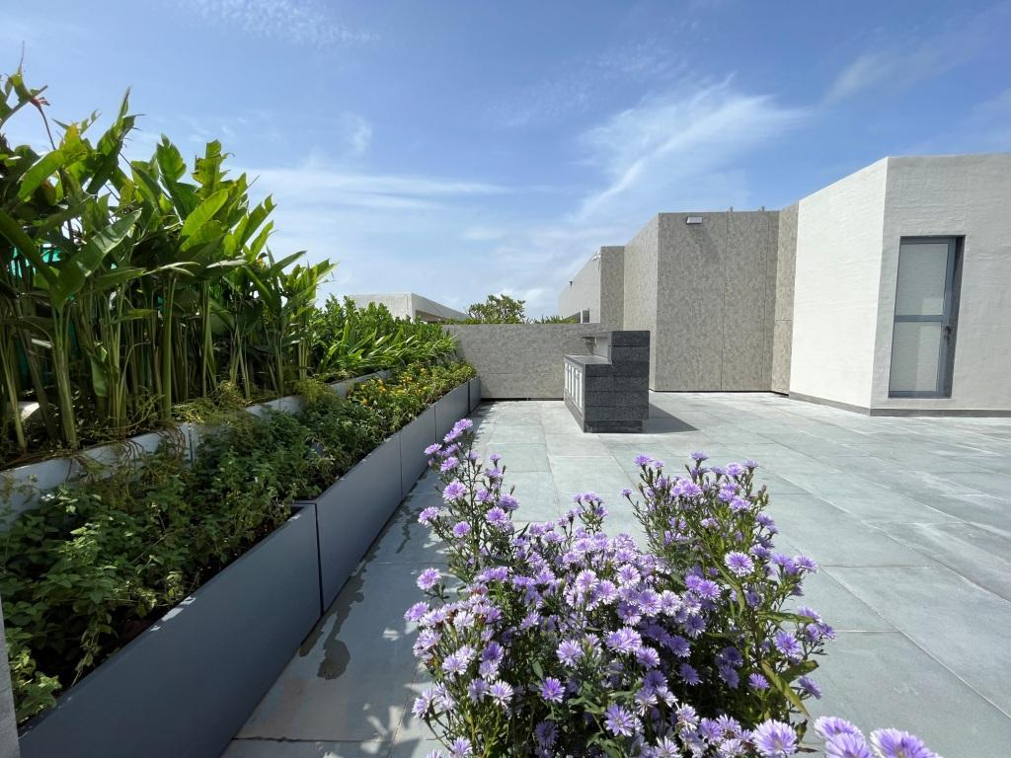
RUSTOMJEE PARAMOUNT, KHAR

Slide 14
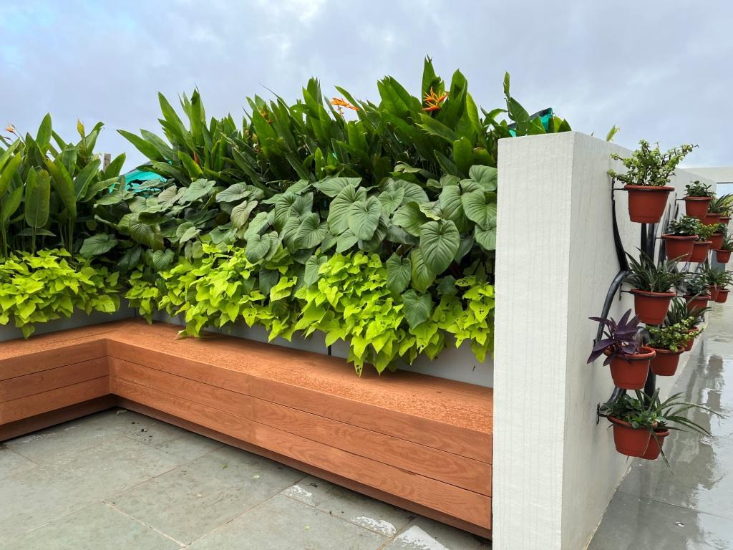
RUSTOMJEE PARAMOUNT, KHAR

Slide 15
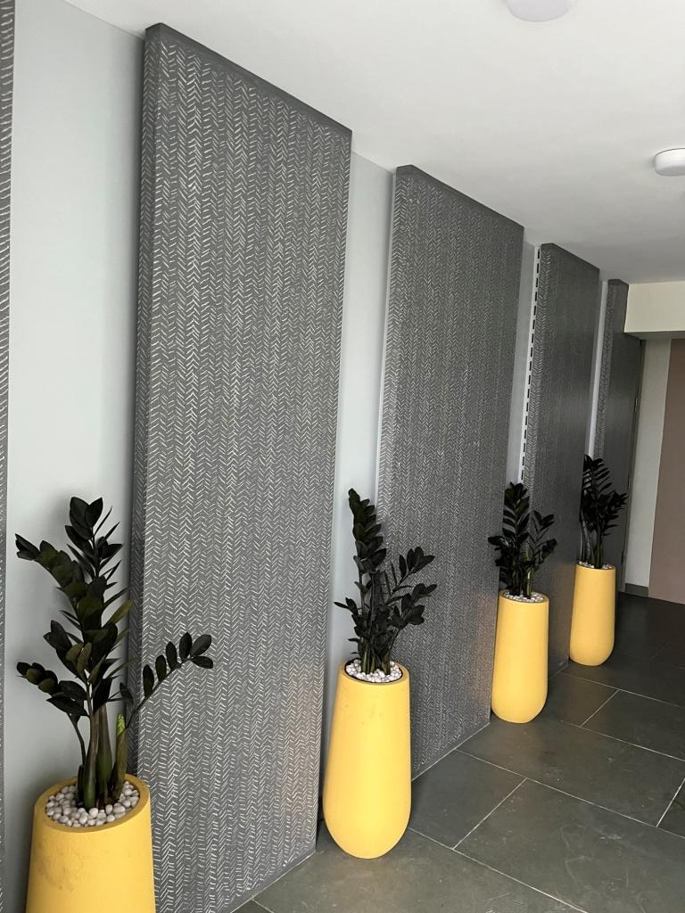
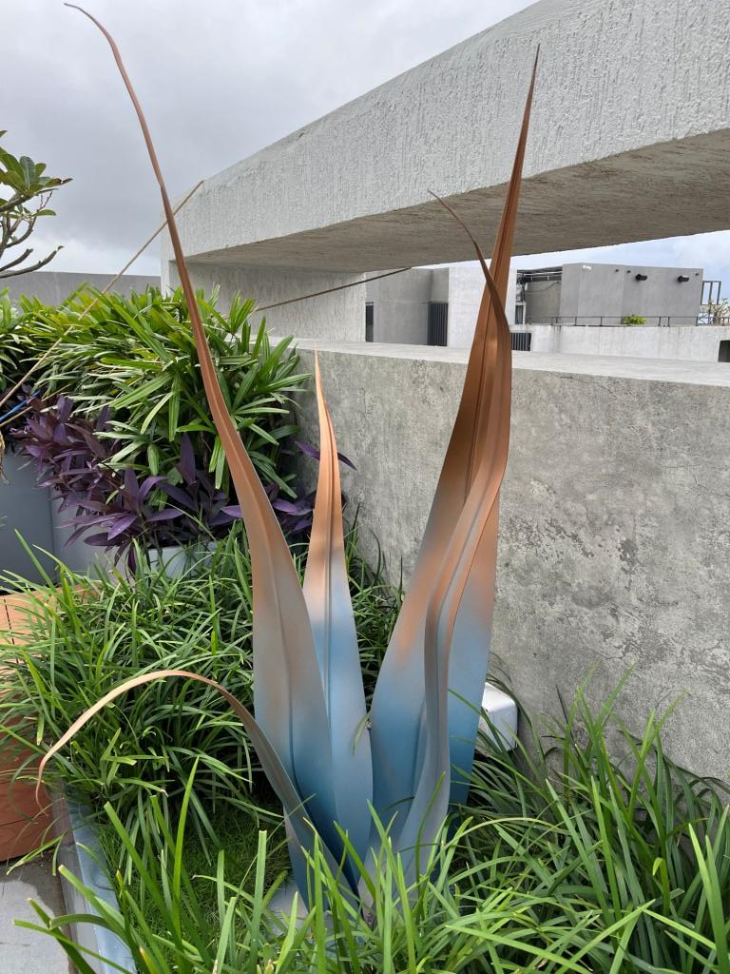
RUSTOMJEE PARAMOUNT, KHAR

Slide 16
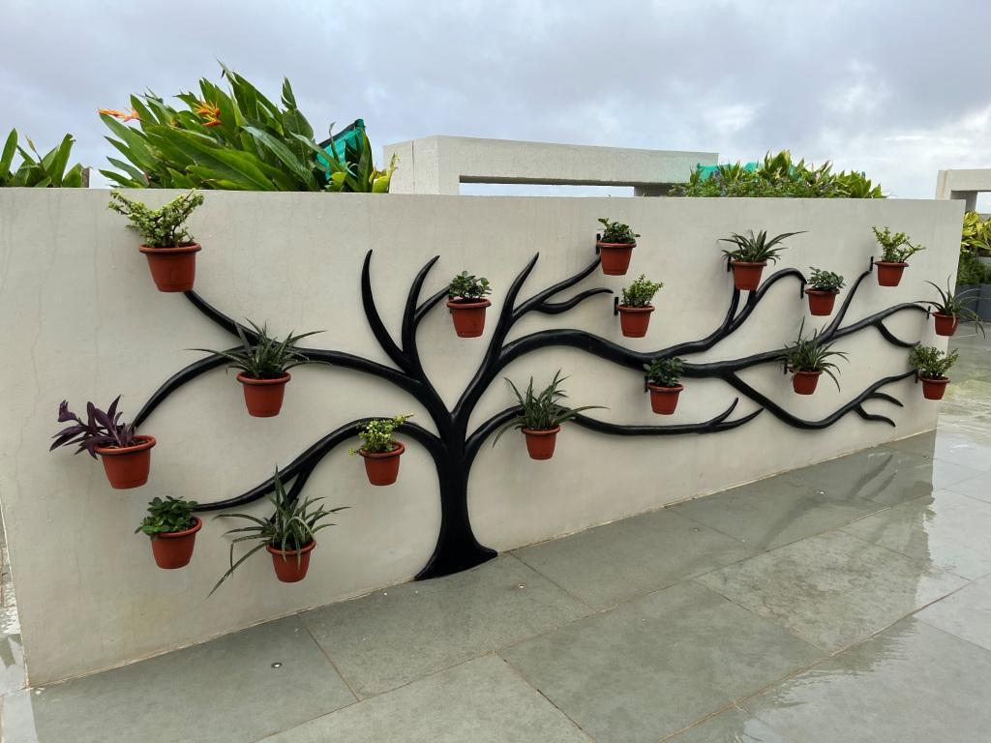
RUSTOMJEE PARAMOUNT, KHAR

Slide 17
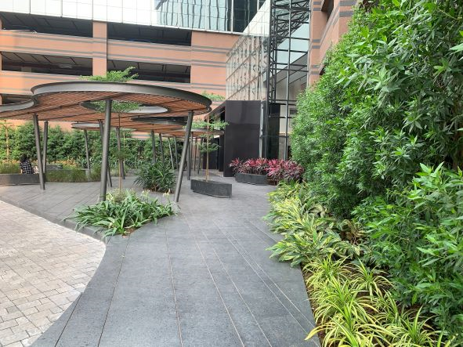
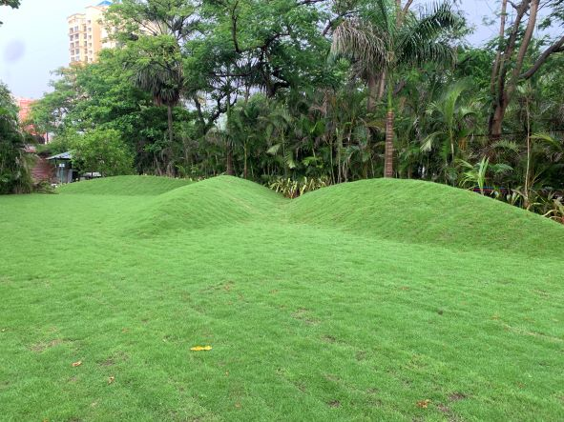
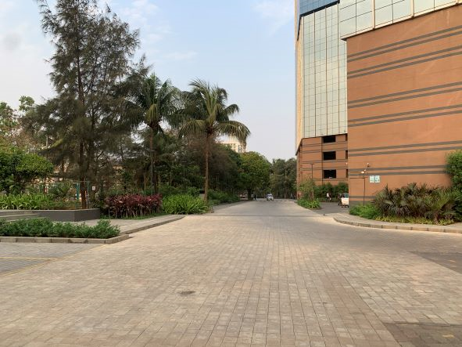
G CORP TECH PARK, THANE

Slide 18
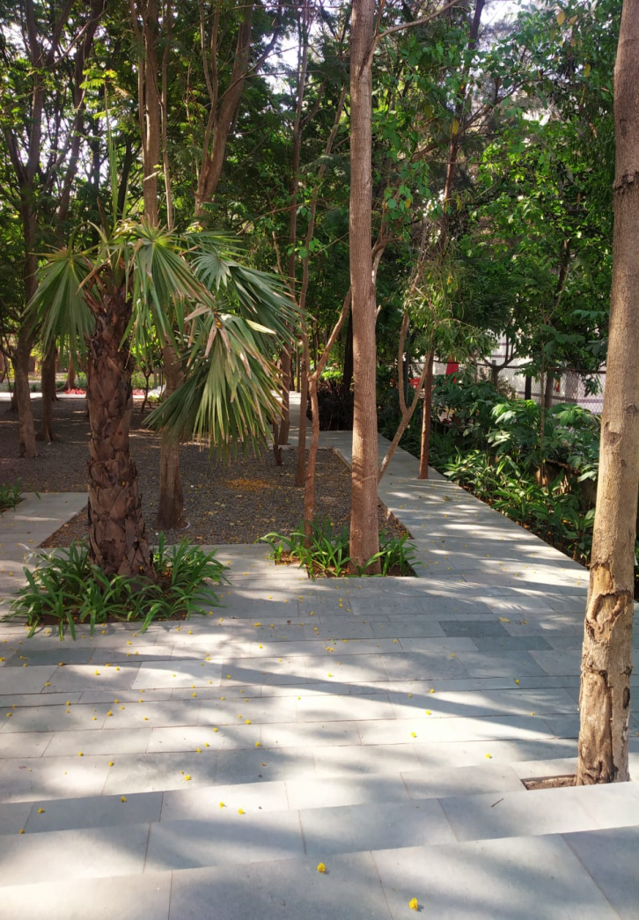
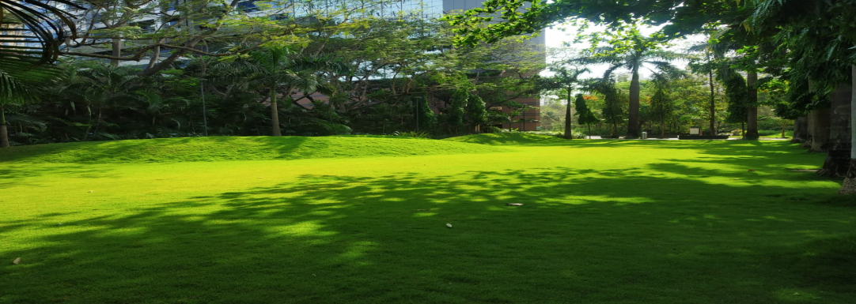
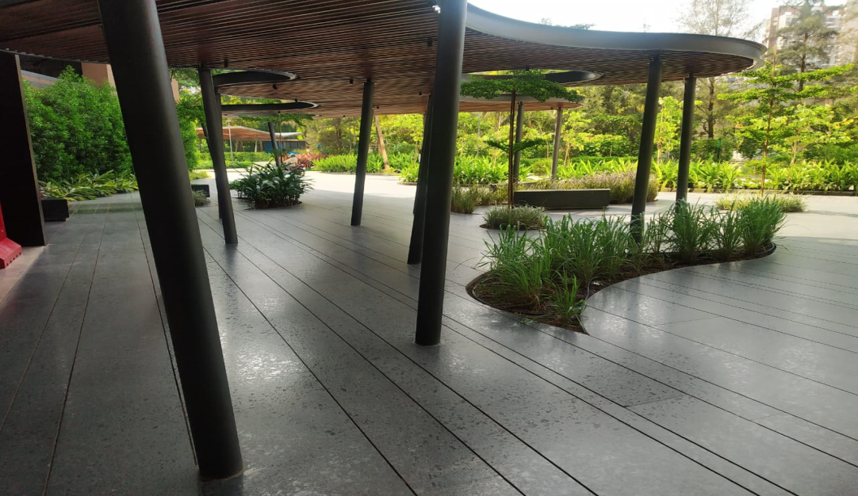
G CORP TECH PARK, THANE

Slide 19


Slide 20
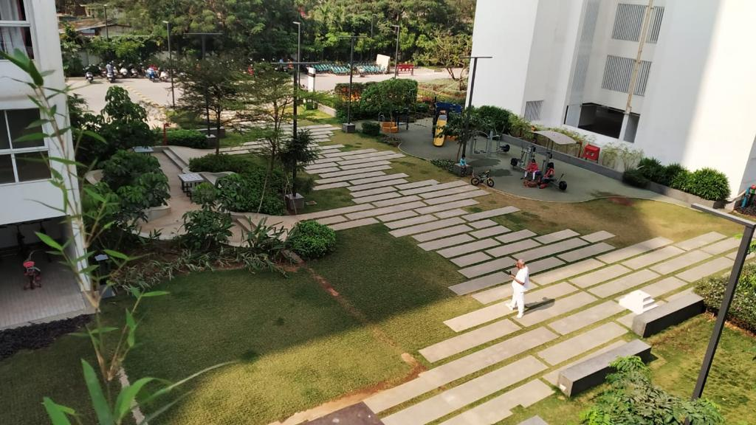

Slide 21
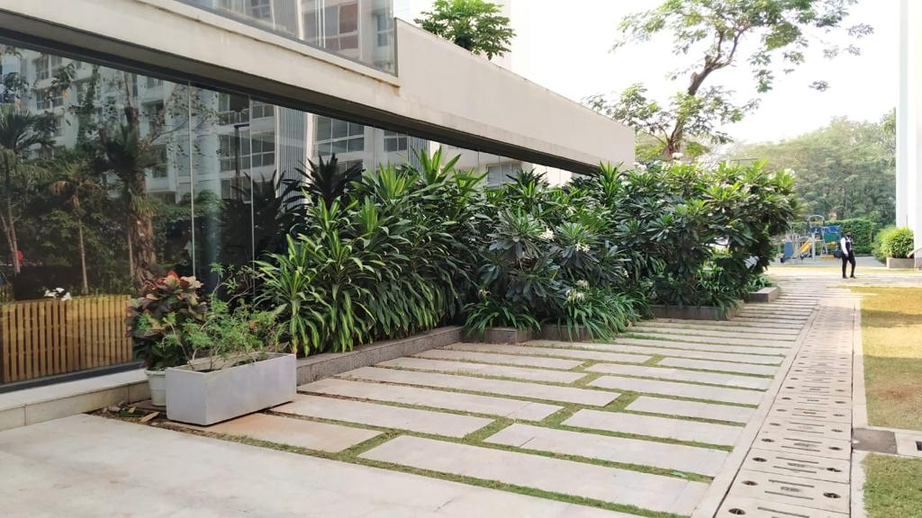

Slide 22
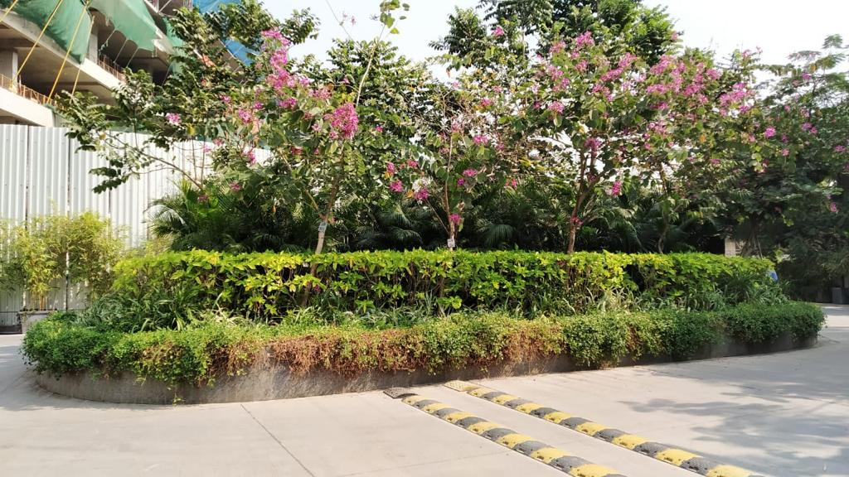

Slide 23
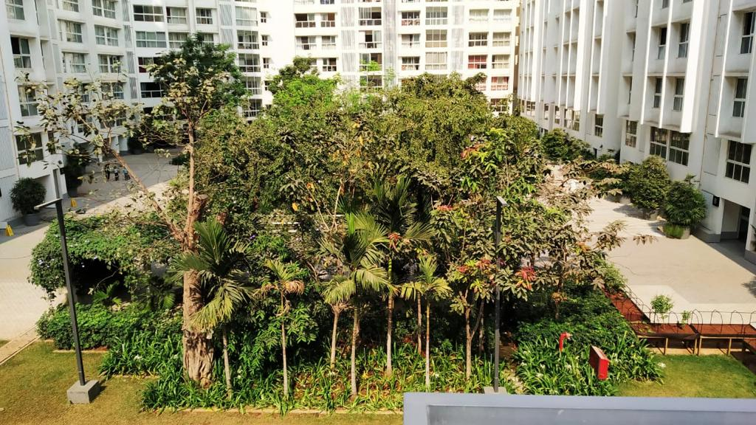

Slide 24
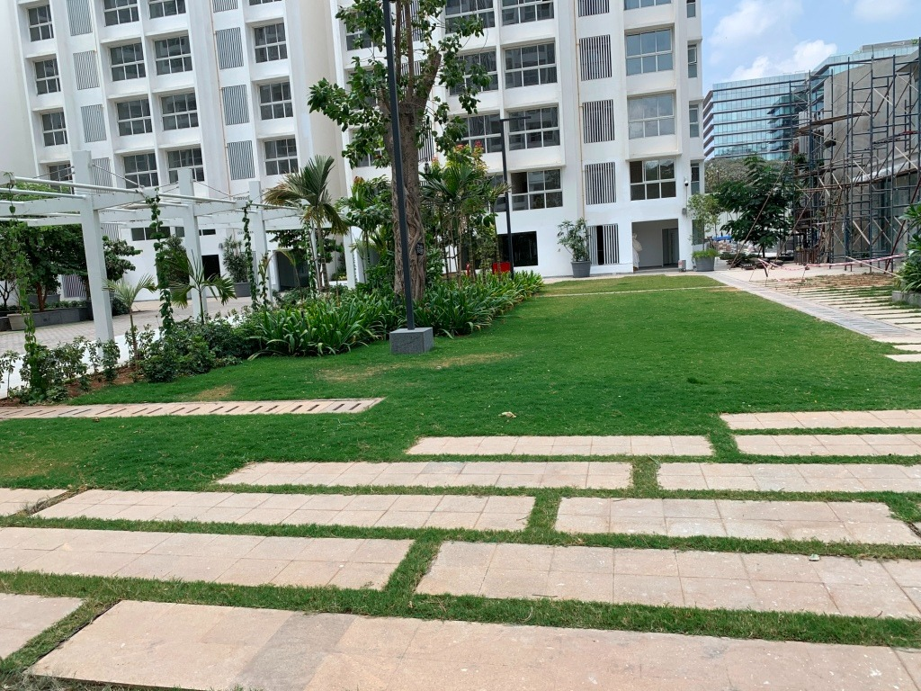

Slide 25
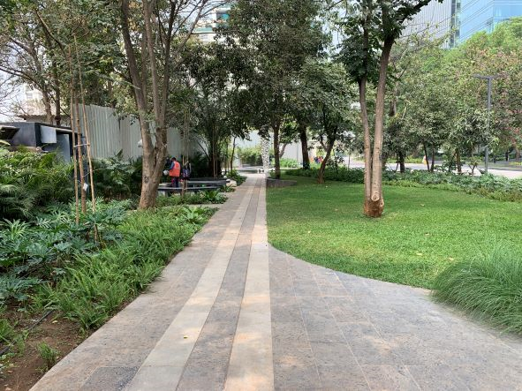
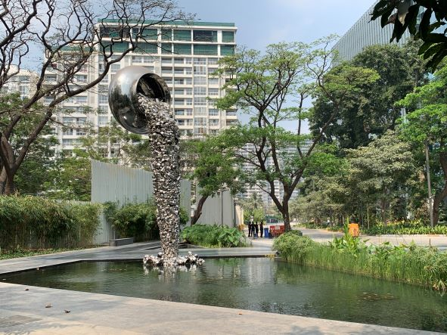
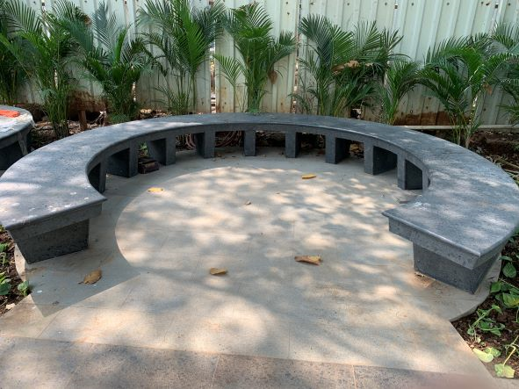
BEER GARDEN @ GODREJ TREES

Slide 26
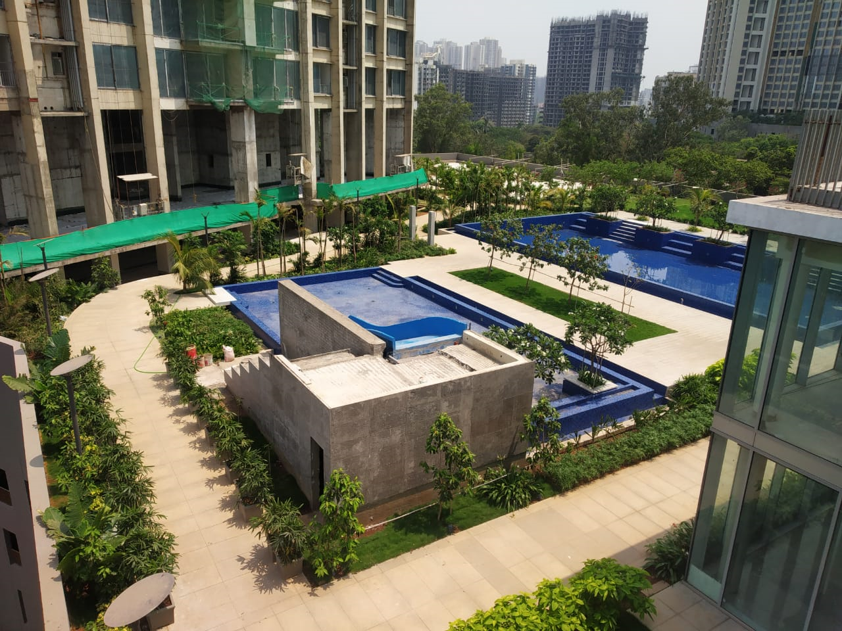
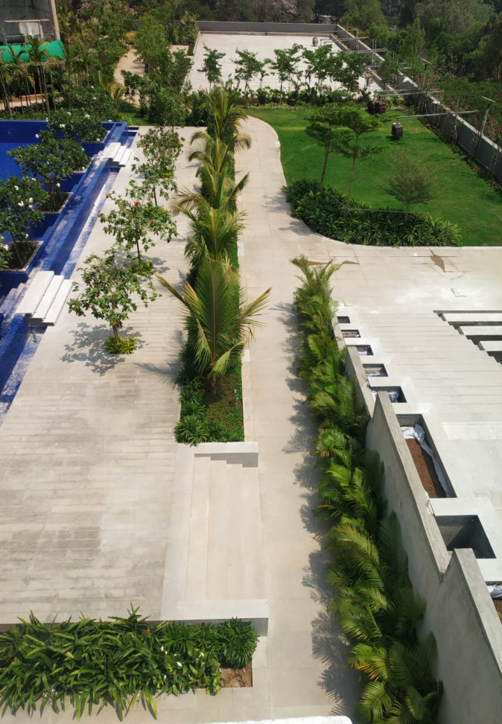
OBEROI ENIGMA, MULUND

Slide 27
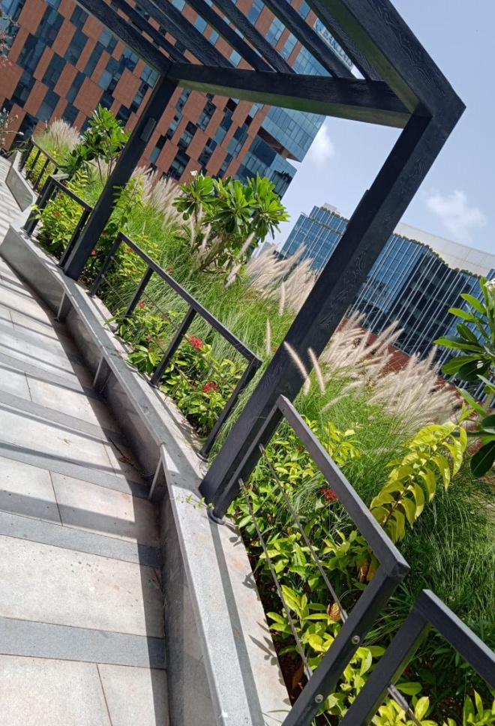
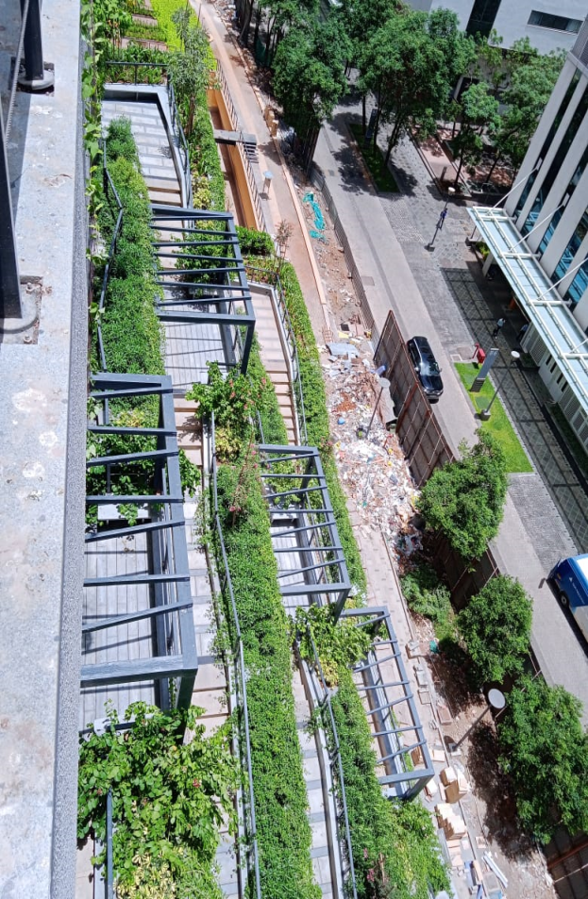
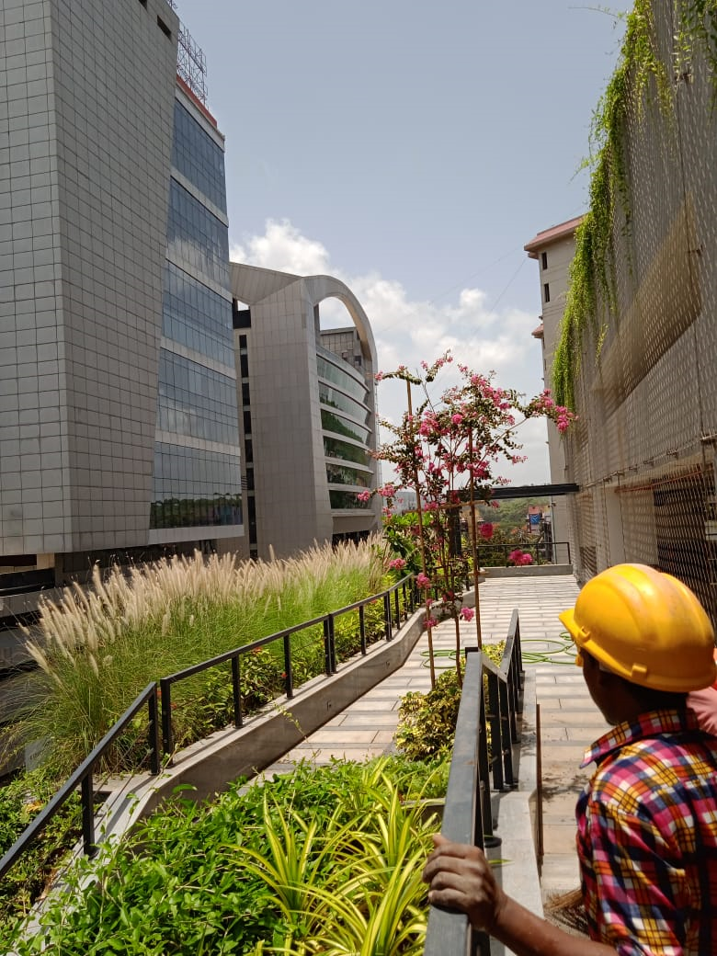
NIRLON, GOREGAON

Slide 28
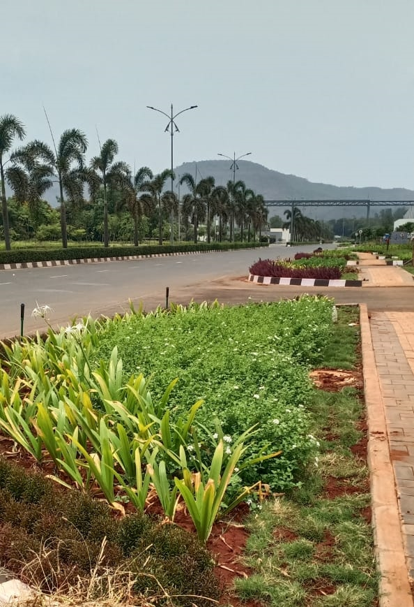
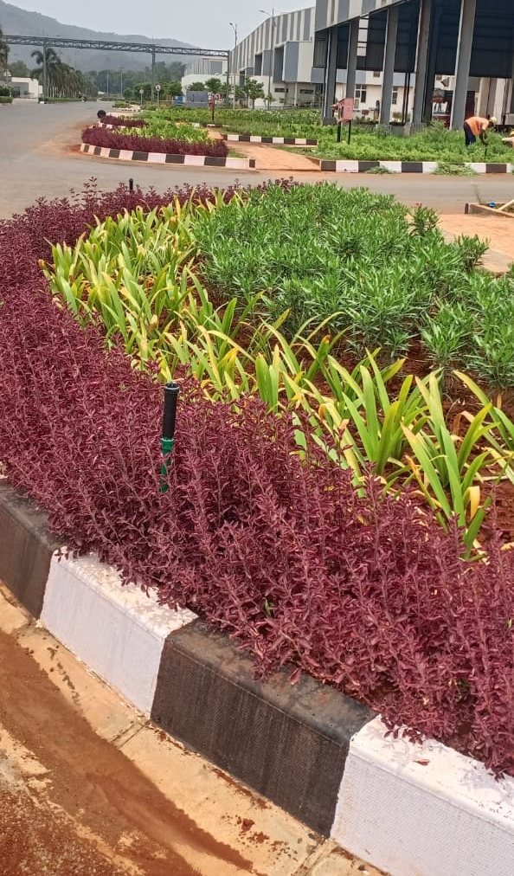
GODREJ & BOYCE FACTORY, KHALAPUR

Slide 29
GODREJ –URBAN FARM

Slide 30
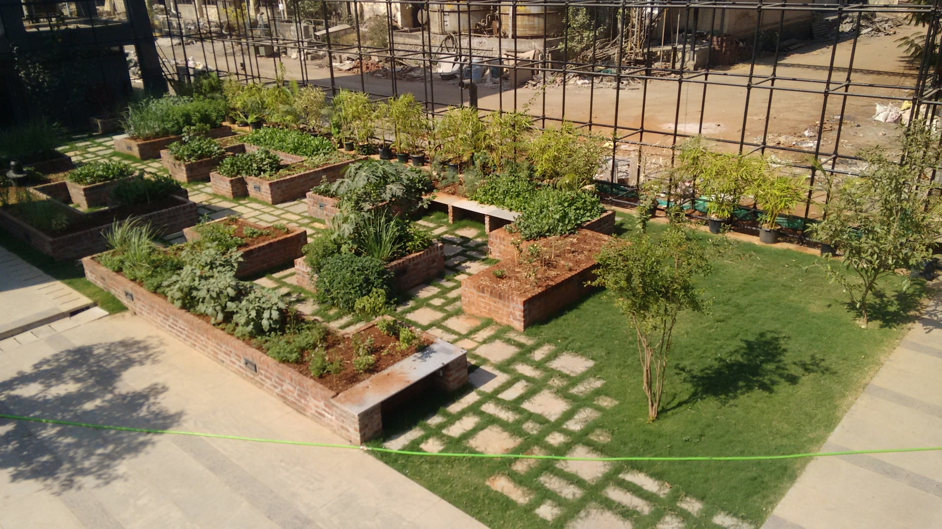

Slide 31
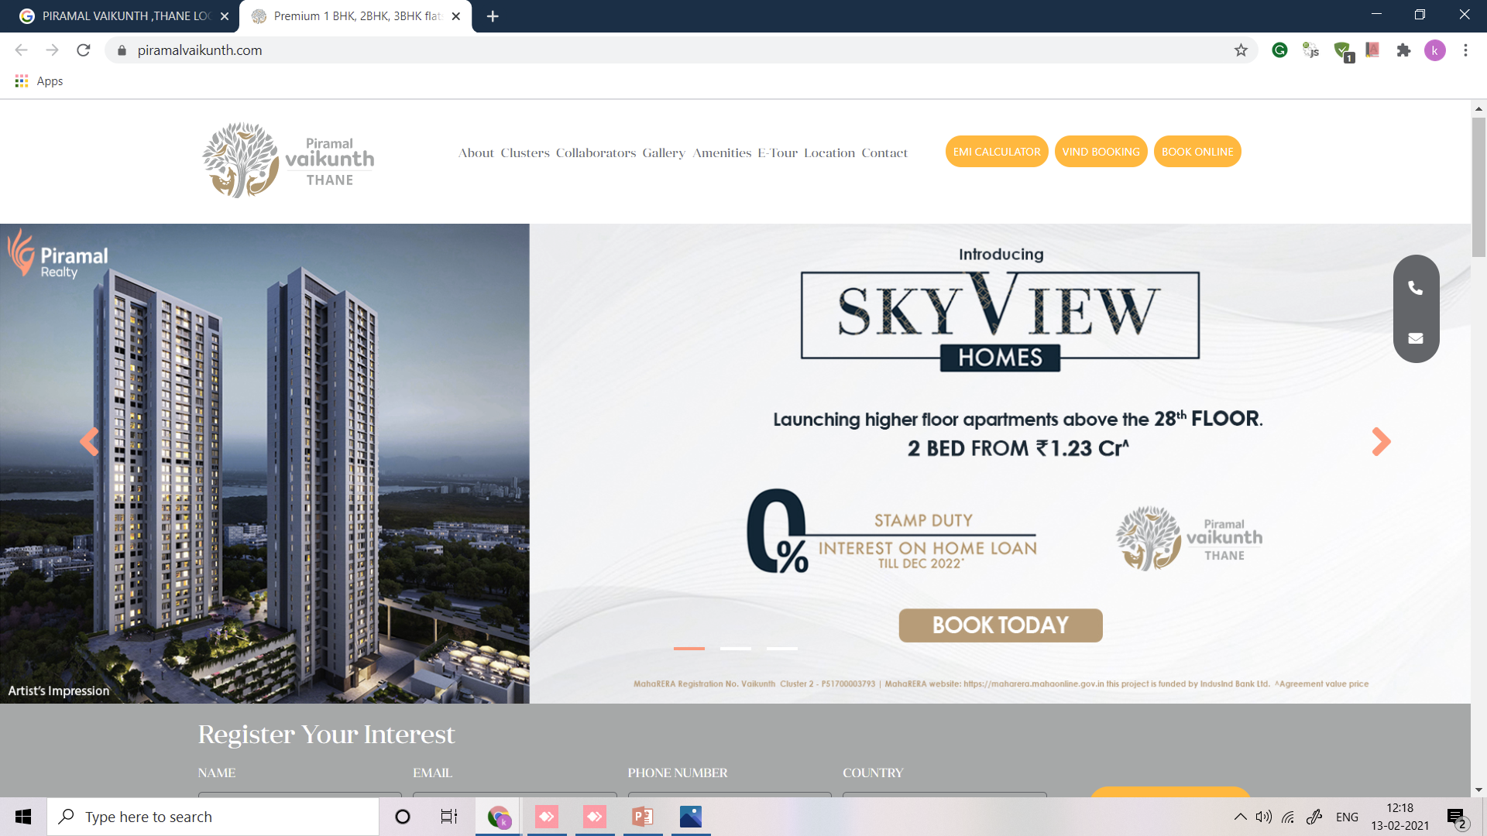

Slide 32
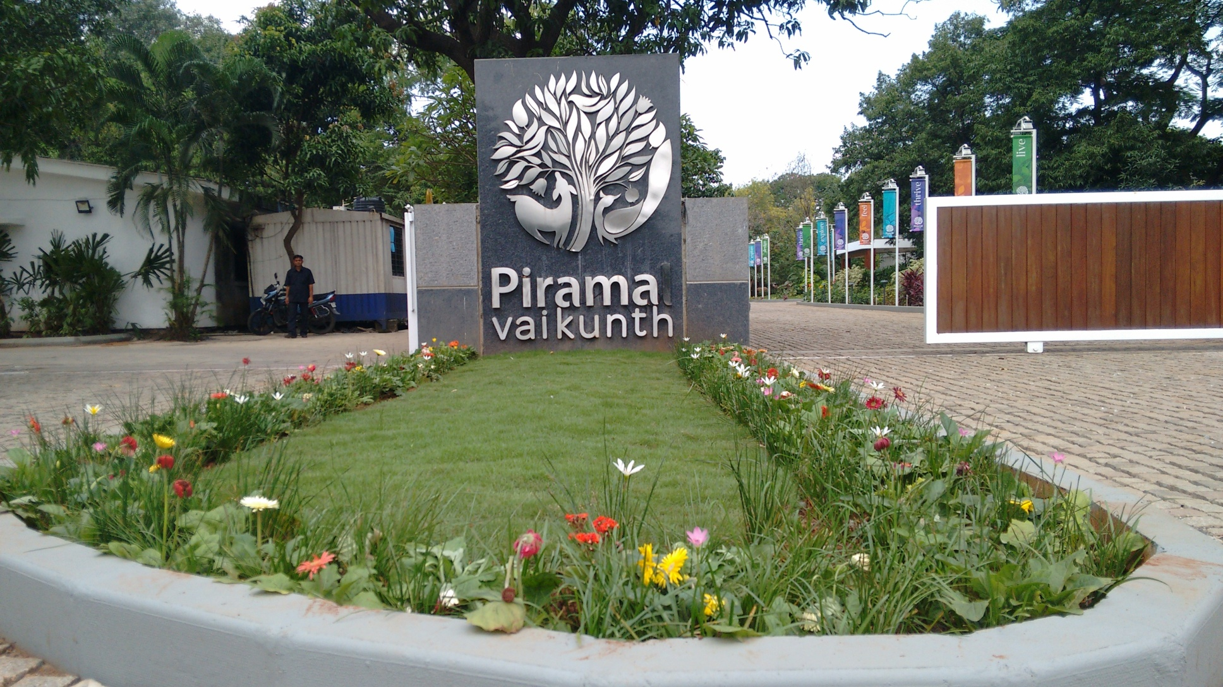

Slide 33
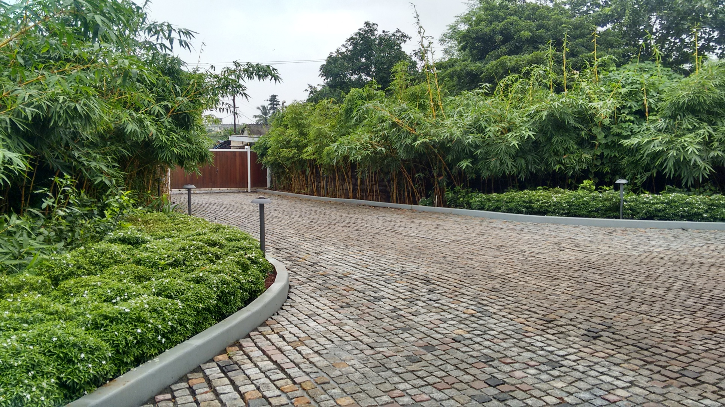

Slide 34
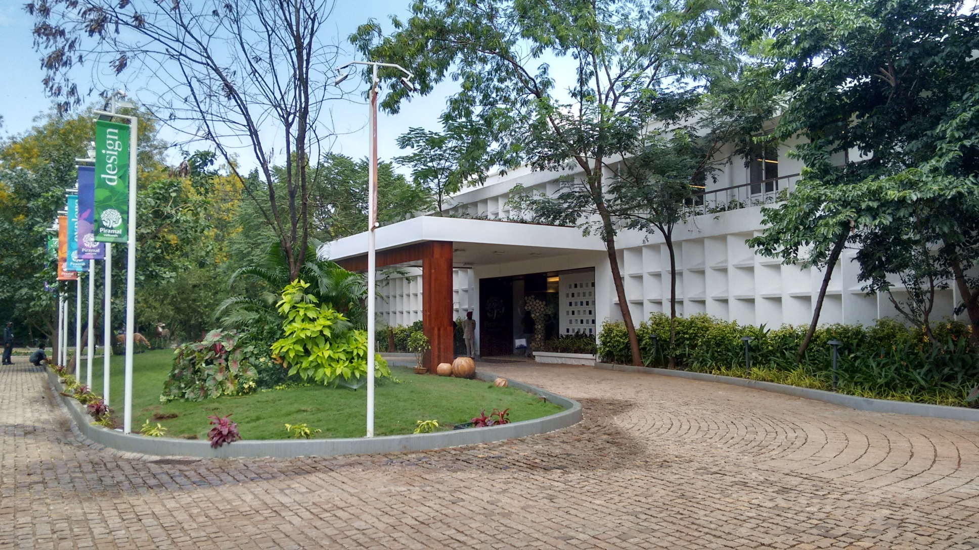

Slide 35
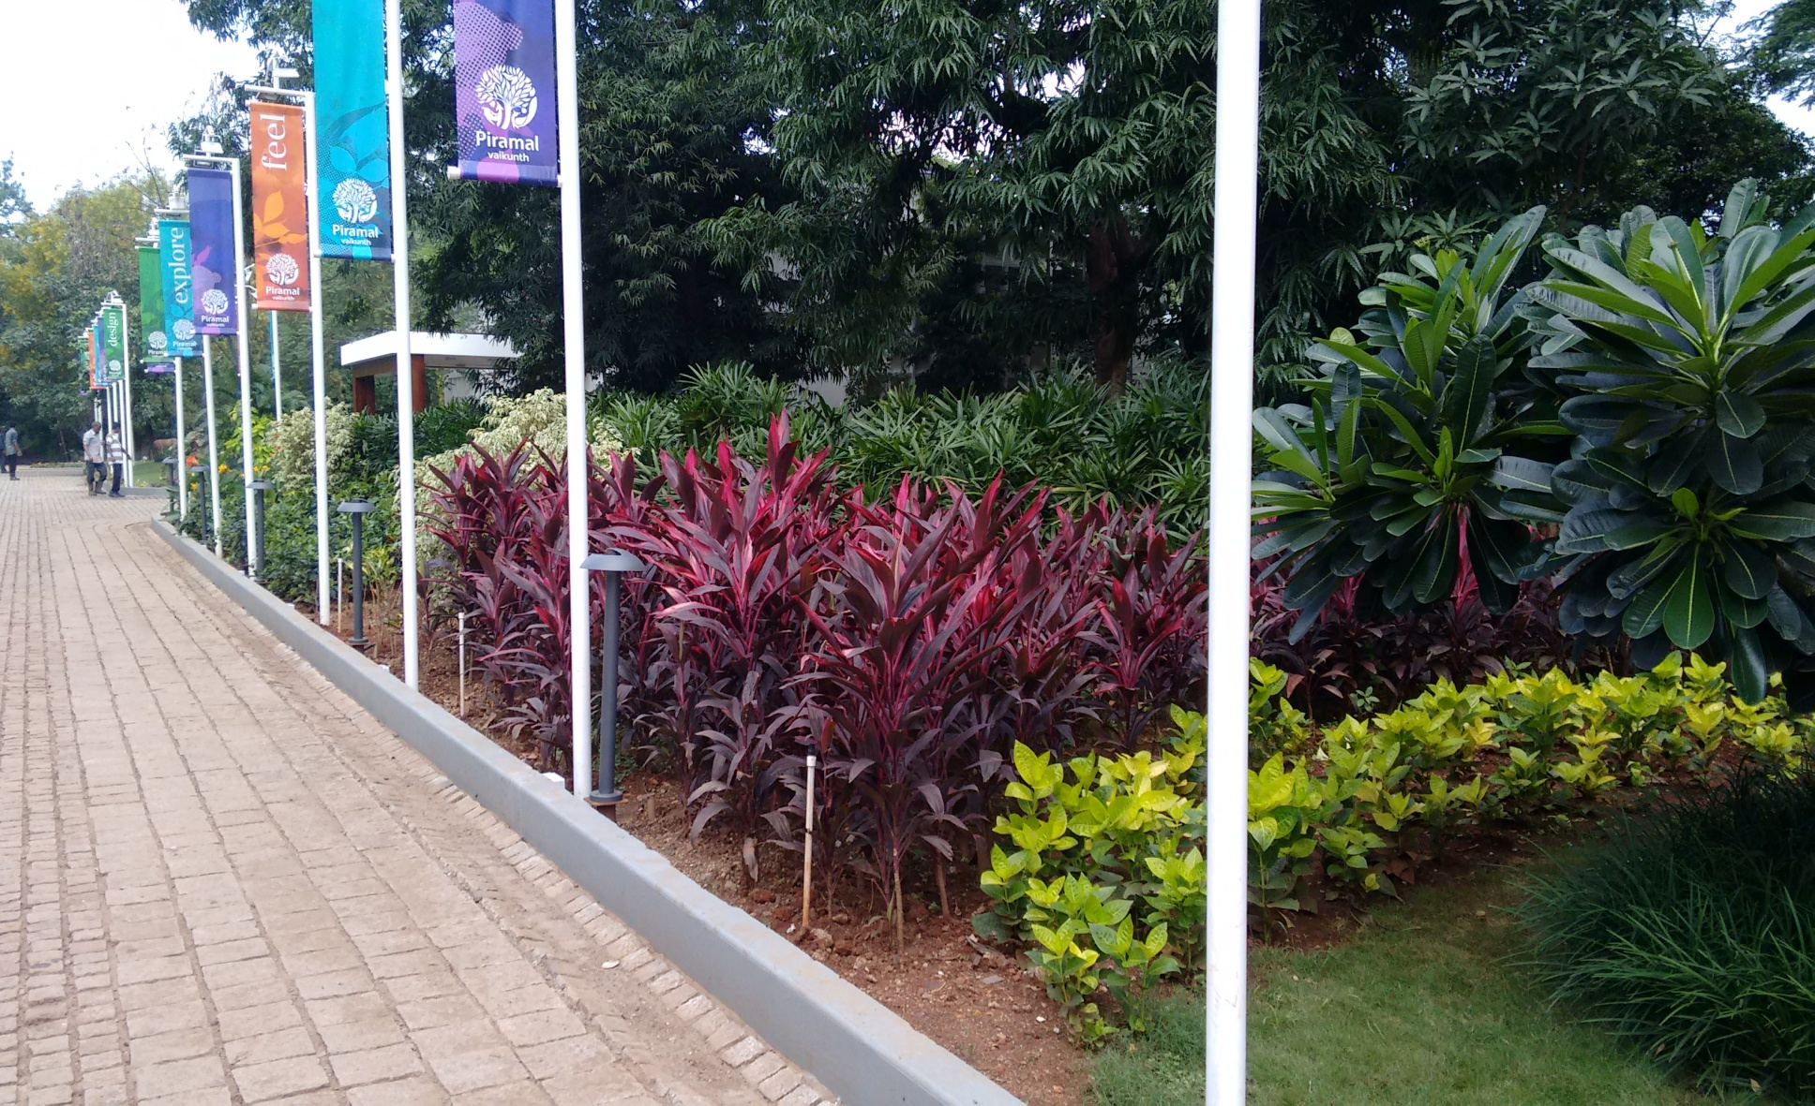

Slide 36
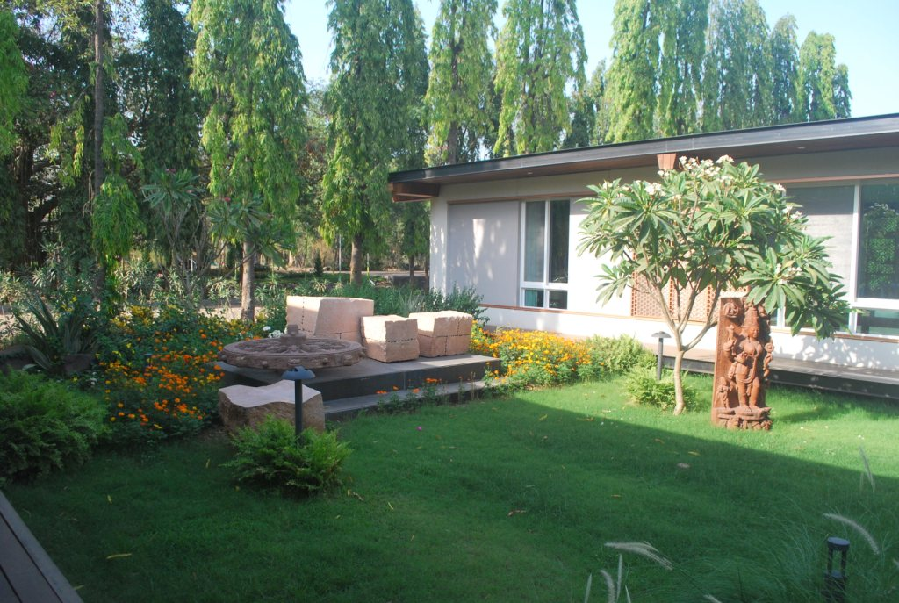

Slide 37
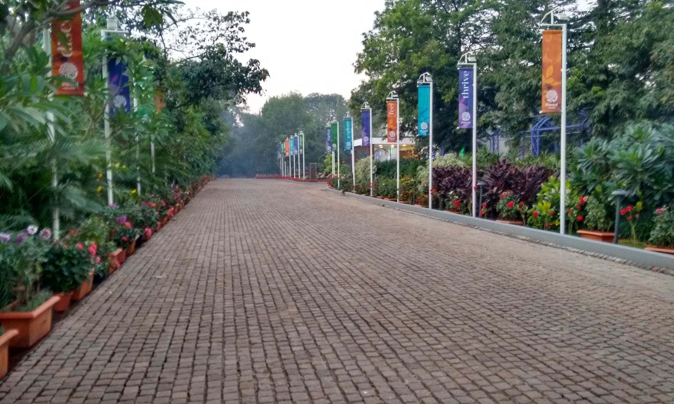

Slide 38
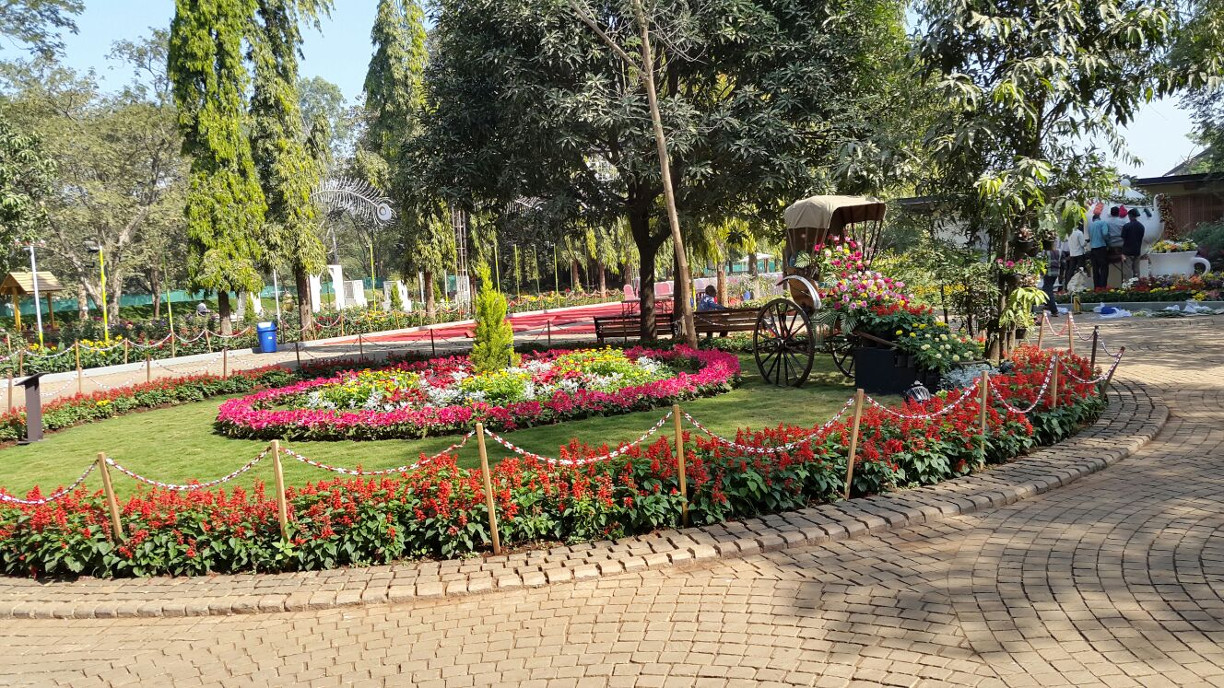

Slide 39
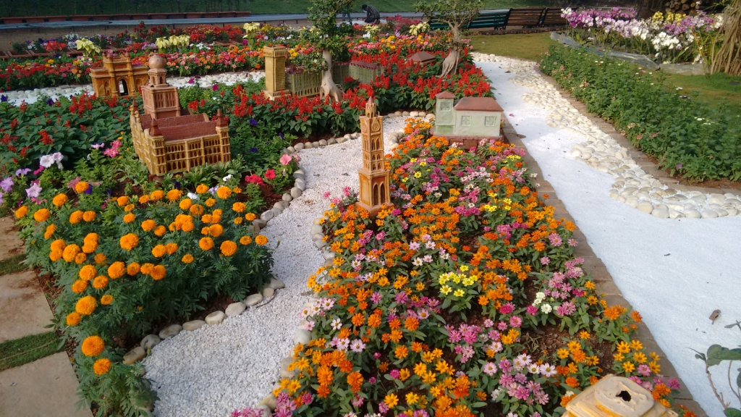

Slide 41
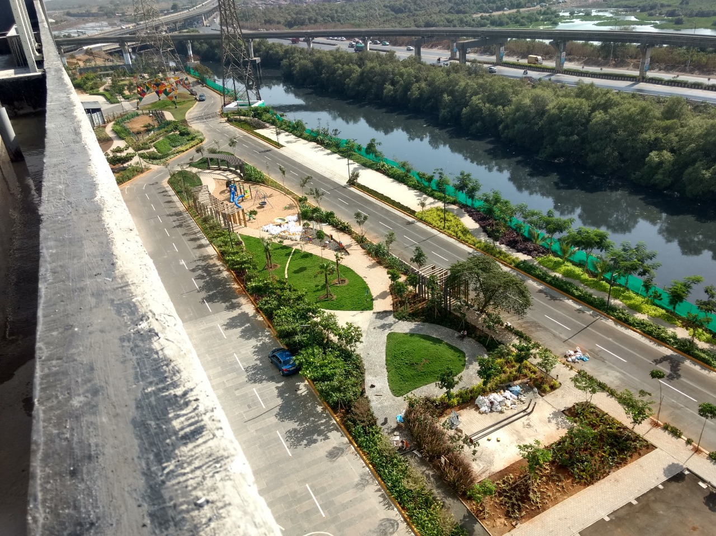

Slide 42
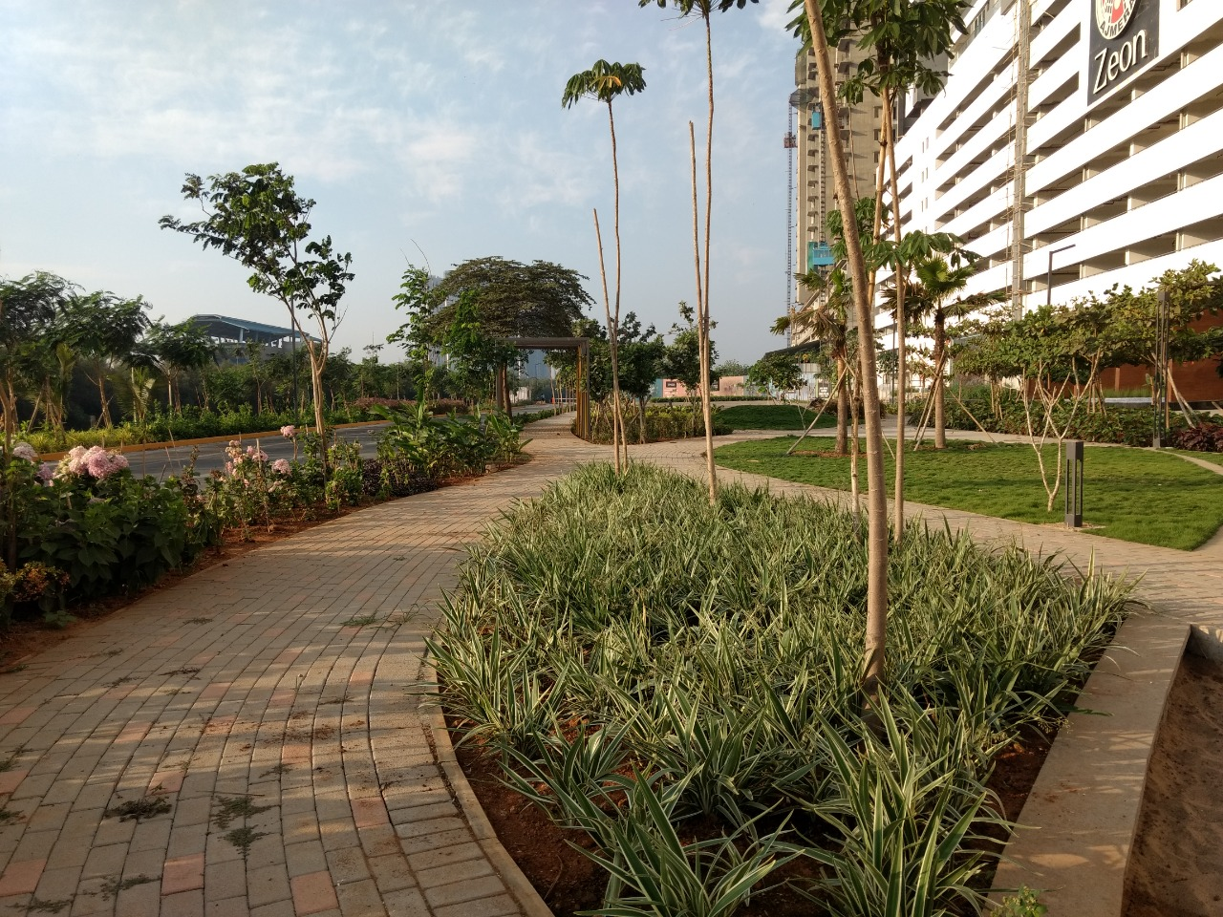

Slide 43
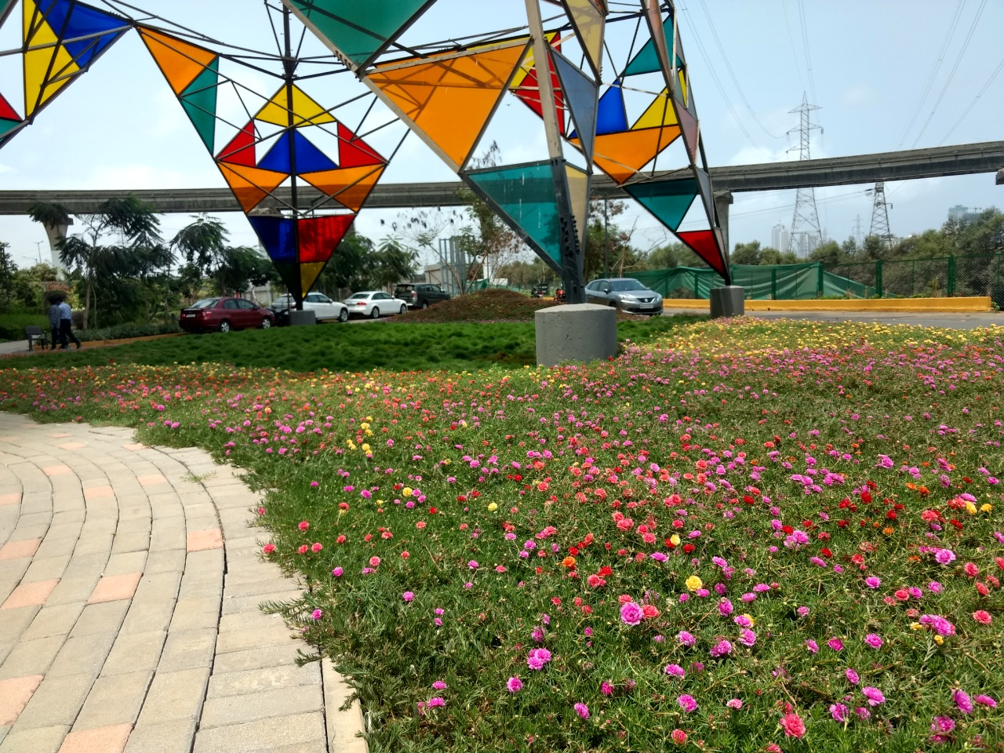

Slide 45
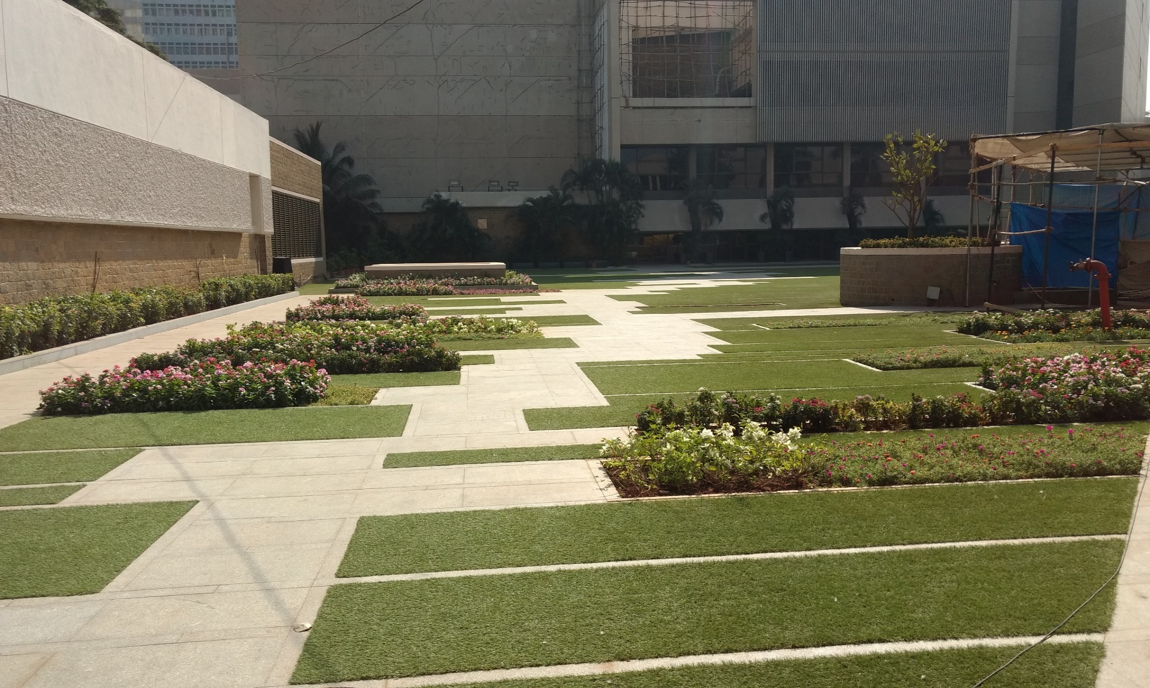

Slide 46


Slide 47
Ambedkar Garden Seawoods (NMMC)

Slide 48


Slide 49


Slide 50


Slide 51
KILBILL BUNGALOW

Slide 52


Slide 53


Slide 54


Slide 55
TERRACE GARDEN

Slide 56


Slide 57


Slide 58


Slide 59


Slide 60
VERTICAL GARDEN

Slide 61


Slide 62



Slide 63


Slide 64


Slide 65


Slide 66
TREE TRANSPLANTING

Slide 67



Slide 68



Slide 69



Slide 70



Slide 71

IRRIGATION

Slide 72
NURSERY

Slide 73


Slide 74


Slide 75
THANK YOU

